Slide 1
HTML5 and the Canvas API
Rami Sayar – Senior Technical Evangelist - @ramisayar
Microsoft Canada

Slide 2

HTML5
Successor to HTML 4.01
Not one specification, but a family of specifications
Driven by standards committees and interested vendors
Latest version is 5.2, and platform is constantly evolving
Adds many new features to the language
Canvas API, Web storage, geolocation, and much more
Enriched semantic content and standard parsing rules
Standardized DOM and DOM APIs
HTML5 + JavaScript = Applications
Notes:
HTML5 is a moving standard in that it is constantly evolving, adding new features and APIs. The reason HTML5 is important is that in addition to enhancing the HTML markup language, it defines dozens of APIs permitting browser-based apps to be nearly as rich as thick-client apps.

Slide 3
HTML5 APIs
Canvas
FileReader
Drag & Drop
WebRTC
Media Stream Extensions
Battery Status
Geolocation
Web Workers
Offline Apps
Media Capture
Clipboard
Ambient Light
Audio and Video
Web Sockets
Forms
Messaging
Calendar
Web Audio
Web Storage
XmlHttp-Request Level 2
Device Orientation
Web Notifications
Contacts
Pointer
Indexed DB
History
Screen Orientation
Fullscreen
WebGL
WebNFC
Notes:
This is merely a partial list of HTML5 APIs, but it helps paint a picture of the comprehensive and expansive nature of the platform. A few descriptions:
Canvas API - Permits apps to draw in the browser window (specifically, onto canvas elements) using a rich 2D drawing API
WebGL - Provides a rich 3D drawing API (not technically part of HTML5, but widely listed as one of its features)
Geolocation API - Allows app to determine user's current location and optionally track location as it changes
Audio and video - Brings native support for playing audio and video files to the browser
Web Audio API - Rich API for synthesizing and playing sound
Web Storage API - Allows browser-based apps to store data on the client side (rather than use cookies, for example)
Indexed DB - Provides object-database storage for client-side data
FileReader API - Permits apps to open and read the content of files selected by the user
Web Worker API - Brings multithreading to JavaScript
Web Sockets API - Facilitates 2-way socket connects between browsers and Web servers
XmlHttpRequest Level 2 - Enhances AJAX with support for cross-domain calls and many other features
Battery Status API - Allows apps to get battery status and respond to changes in battery status through BatteryManager interface (great for mobile apps written in HTML5)
Ambient Light API - Event-based API for detecting and responding to changes in ambient light level

Slide 4
Getting the User's Current Location
navigator.geolocation.getCurrentPosition(onPositionReady);
.
.
.
// Callback
function onPositionReady(position) {
var latitude = position.coords.latitude;
var longitude = position.coords.longitude;
var altitude = position.coords.altitude;
var accuracy = position.coords.accuracy;
var timestamp = position.timestamp;
}
Notes:
This is just one example of the many things you can do with HTML5: get the user's current location using the geolocation API. For security reasons, a browser will never divulge this information without prompting the user. This is useful for building location-aware applications -- for example, apps that locate the store nearest you, recommend restaurants in your vicinity, or provide navigational aids as you drive down the highway.

Slide 5
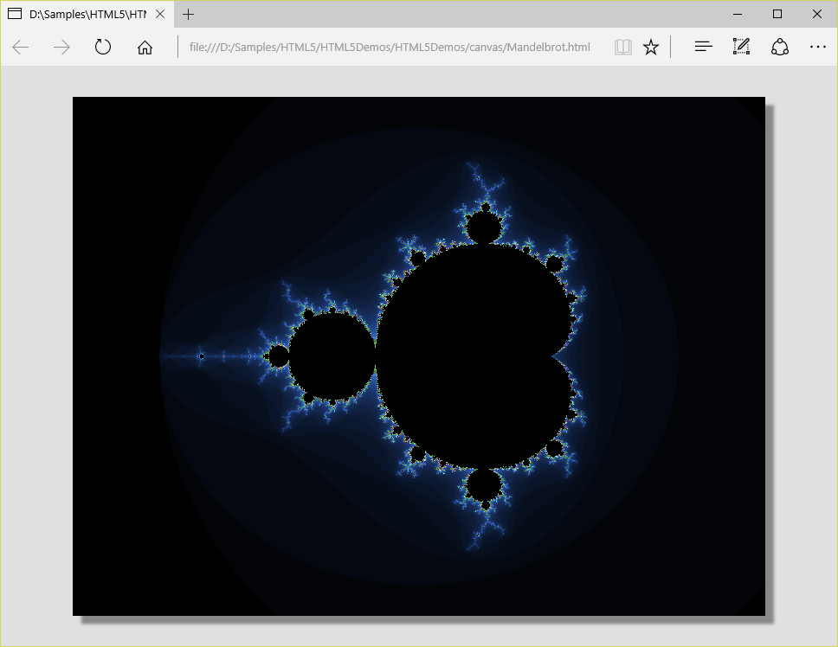
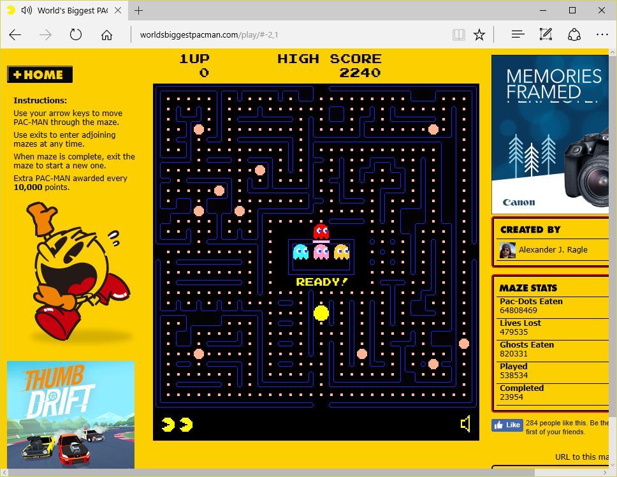
The HTML5 Canvas API
API for drawing to a Web page from JavaScript
The basis for rich UIs, data-driven UIs, games, and more
Notes:
The Canvas API is one of HTML5's most compelling APIs because it provides a mechanism for drawing into a browser window using JavaScript code. Real-world examples abound. The Web page on the left uses the Canvas API to draw the Mandelbrot set. The one on the right, which can be viewed at http://worldsbiggestpacman.com/, uses the Canvas API to implement Pac-Man.

Slide 6
The <canvas> Element
Pixel-addressable drawing surface for rendering text, graphics, and other visual elements
getContext method retrieves rendering context
toDataUrl method returns data URL containing canvas bitmap
CanvasRenderingContext2d methods and properties provide 2D immediate-mode drawing API
IE
Chrome
Firefox
Opera
Safari
9+
4+
2+
9+
3.1+
Notes:
Drawing into a Web page begins by declaring (or programmatically creating) one or more <canvas> elements. These elements represent drawing surfaces. To draw on a canvas, you begin by retrieving a rendering context for that canvas -- an instance of CanvasRenderingContext2d. You then call CanvasRenderingContext2d methods to draw lines, shapes, text, images, and other entities. You cannot draw outside the surface of a canvas. The Canvas API enjoys widespread support among HTML5 browsers; it was one of the earliest HTML5 APIs implemented by most browser vendors.

Slide 7
Detecting Canvas Support
if (document.createElement("canvas").getContext) {
// Canvas API is supported
}
Notes:
This is a simple test that works in all browsers. It determines whether the host browser supports the HTML5 Canvas API.

Slide 8
CanvasRenderingContext2d
Provides methods for drawing primitives
Provides properties affecting what's drawn, including:
strokeStyle and fillStyle
lineWidth, lineCap, lineJoin, and miterLimit
shadowOffsetX, shadowOffsetY, shadowBlur, and shadowColor
font, textAlign, textBaseline
Provides save and restore methods for saving and restoring canvas state (property values, transformation matrix, etc.)
Also includes globalAlpha and globalCompositeOperation properties ("global" properties)
Notes:
What developers refer to as the "Canvas API" is really the set of methods and properties exposed by the rendering context, which is an instance of CanvasRenderingContext2d. It exposes dozens of methods and properties that you can use to draw entities onto a canvas.

Slide 9
Getting a Rendering Context
// HTML
<canvas id="output" width="400" height="200"></canvas>
// JavaScript
var canvas = document.getElementById("output");
var dc = canvas.getContext("2d");
Notes:
Calling getContext on a <canvas> element returns a reference to an instance of CanvasRenderingContext2d.

Slide 10

Drawing a Rectangle
// HTML
<canvas id="output" width="400" height="200"></canvas>
// JavaScript
var canvas = document.getElementById("output");
var dc = canvas.getContext("2d");
dc.strokeRect(100, 50, 200, 100);
Notes:
The strokeRect method of CanvasRenderingContext2d draws a stroked (unfilled) rectangle.

Slide 11
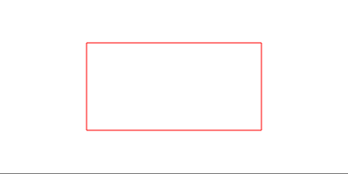
Changing the Stroke Color
var canvas = document.getElementById("output");
var dc = canvas.getContext("2d");
dc.strokeStyle = "red";
dc.strokeRect(100, 50, 200, 100);
Notes:
You can change the stroke color of figures that you draw by assigning a color value to the rendering context's strokeStyle property before drawing. In this example, the property is assigned the CSS color value "red."

Slide 12
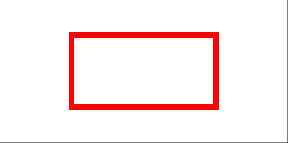
Changing the Stroke Width
var canvas = document.getElementById("output");
var dc = canvas.getContext("2d");
dc.strokeStyle = "red";
dc.lineWidth = 8;
dc.strokeRect(100, 50, 200, 100);
Notes:
Similarly, you can change the width of the strokes that you draw using the rendering context's linewidth property.

Slide 13

Drawing a Filled Rectangle
var canvas = document.getElementById("output");
var dc = canvas.getContext("2d");
dc.fillRect(100, 50, 200, 100);
Notes:
To draw a filled rectangle, you call fillRect rather than strokeRect.

Slide 14

Changing the Fill Color
var canvas = document.getElementById("output");
var dc = canvas.getContext("2d");
dc.fillStyle = "red";
dc.fillRect(100, 50, 200, 100);
Notes:
You can change the color of the filled figures that you draw by assigning a value to the rendering context's fillStyle property. In this example, the property is assigned the CSS color value "red."

Slide 15
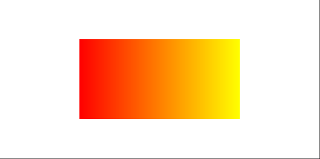
Filling with Linear Gradients
var gradient = dc.createLinearGradient(100, 50, 300, 50);
gradient.addColorStop(0, "red");
gradient.addColorStop(1, "yellow");
dc.fillStyle = gradient;
dc.fillRect(100, 50, 200, 100);
Notes:
fillStyle can also be assigned a gradient value. The four parameters passed to createLinearGradient are the coordinates x0, y0, x1, and y1, specifying the line along which the gradient is drawn. It's weird to have to set the gradient coordinates along with the rectangle coordinates, but you can take care of that by translating the origin before drawing. You can also fill rectangles (and other shapes) with radial gradients and with "patterns" -- images, videos, and other canvases.

Slide 16

Drawing Text
dc.font = "bold 72pt sans-serif";
dc.strokeStyle = "red";
dc.strokeText("HTML5", 40, 130);
Notes:
The strokeText method draws unfilled text. Properties such as font and strokeStyle control the visual attributes of the text that you draw.

Slide 17

Drawing Filled Text
dc.font = "bold 72pt sans-serif";
dc.fillStyle = "red";
dc.fillText("HTML5", 40, 130);
Notes:
The fillText method draws filled text. Although not shown here, you can draw gradient text by assigning a gradient to fillStyle.

Slide 18

Drawing Drop Shadows
dc.shadowOffsetX = 4;
dc.shadowOffsetY = 4;
dc.shadowBlur = 8;
dc.shadowColor = "rgba(0, 0, 0, 0.5)";
dc.font = "bold 72pt sans-serif";
dc.fillStyle = "red";
dc.fillText("HTML5", 40, 130);
Notes:
You can draw drop shadows behind anything you draw with the Canvas API. The shadowOffsetX, shadowOffsetY, shadowBlur, and shadowColor properties of CanvasRenderingContext2d control the depth, color, and blurriness of the shadow. Note that alpha value of 0.5, which allows objects behind the drop shadow to partially show through. The ability to include alpha values in colors is new in HTML5. Note that "rgba(…)" is a string. It doesn't work if you omit the quotation marks.

Slide 19
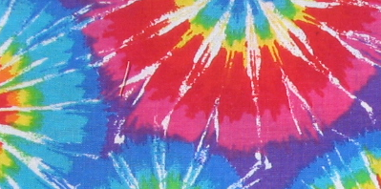
Drawing an Image
// HTML
<img id="flowers" src="flowers.jpg" style="display: none" />
<canvas id="output" width="400" height="200"></canvas>
// JavaScript
window.onload = function () {
var canvas = document.getElementById("output");
var dc = canvas.getContext("2d");
var image = document.getElementById("flowers");
dc.drawImage(image, 0, 0);
}
Notes:
The image drawn here – flowers.jpg – is much larger than the canvas, but it is clipped to the canvas.

Slide 20
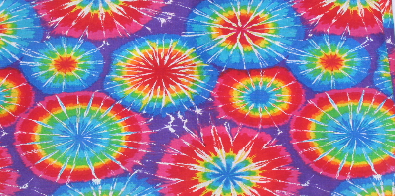
Drawing and Scaling an Image
// HTML
<img id="flowers" src="flowers.jpg" style="display: none" />
<canvas id="output" width="400" height="200"></canvas>
// JavaScript
window.onload = function () {
var canvas = document.getElementById("output");
var dc = canvas.getContext("2d");
var image = document.getElementById("flowers");
dc.drawImage(image, 0, 0, canvas.width, canvas.height);
}
Notes:
This examples scales the image to exactly fit the canvas's width and height.

Slide 21
Loading and Drawing an Image
// HTML
<canvas id="output" width="400" height="200"></canvas>
// JavaScript
var image = new Image();
image.src = "flowers.jpg";
image.onload = function () {
dc.drawImage(image, 0, 0);
}
Notes:
Rather than declare the image that you draw in the HTML, you can programmatically load the image. It is important not to draw the image until the browser fires an onload event indicating that the image has been loaded.

Slide 22

Generating an Image
var bitmap = dc.createImageData(100, 100);
for (x = 0; x < bitmap.width; x++)
for (y = 0; y < bitmap.height; y++)
drawRandomColor(bitmap, x, y);
dc.putImageData(bitmap, 0, 0);
function drawRandomColor(bitmap, x, y) {
var index = (x + y * bitmap.width) << 2;
bitmap.data[index + 0] = Math.random() * 256; // Red
bitmap.data[index + 1] = Math.random() * 256; // Green
bitmap.data[index + 2] = Math.random() * 256; // Blue
bitmap.data[index + 3] = 255; // Alpha
}
Notes:
This example generates a 100 x 100 image containing random colors and renders it to a canvas. It begins by calling createImageData to create an imageData object, whose data properties exposes the ARGB components of each pixel in the image. Then it assigns random values to the R, G, and G components of each pixel. One use for this technique is writing apps that draw fractal images.

Slide 23
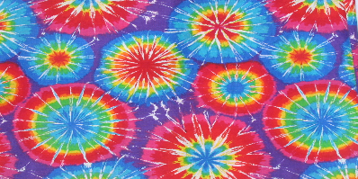
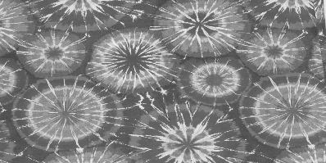
Modifying an Image
var image = new Image();
image.src = "flowers.jpg";
image.onload = function () {
dc.drawImage(image, 0, 0, canvas.width, canvas.height);
bitmap = dc.getImageData(0, 0, canvas.width, canvas.height);
for (x = 0; x < bitmap.width; x++)
for (y = 0; y < bitmap.height; y++)
toGray(bitmap, x, y); // Helper function
dc.putImageData(bitmap, 0, 0);
}
Notes:
With this technique, it is possible to build photo-editing apps using HTML5. The toGray() function isn't shown, but is implemented like this:
function toGray(bitmap, x, y) {
var index = (x + y * bitmap.width) << 2;
var r = bitmap.data[index + 0];
var g = bitmap.data[index + 1];
var b = bitmap.data[index + 2];
var gray = (0.3 * r) + (0.59 * g) + (0.11 * b);
bitmap.data[index + 0] = gray;
bitmap.data[index + 1] = gray;
bitmap.data[index + 2] = gray;
}

